Slide 1

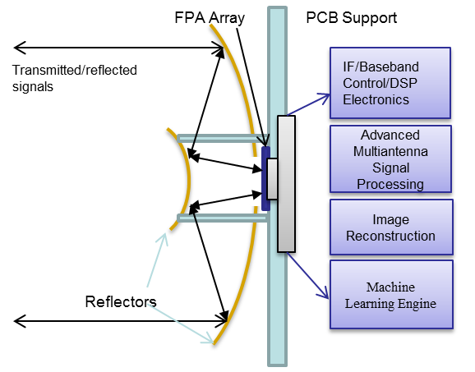
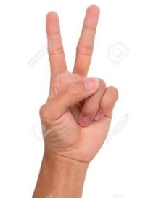
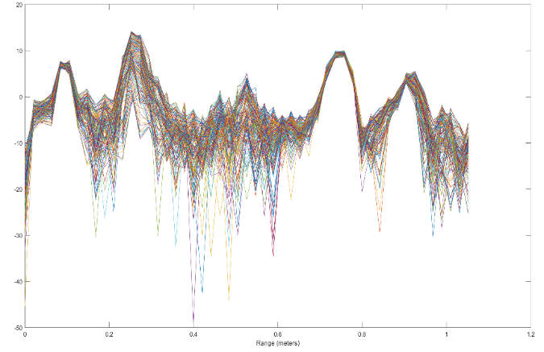
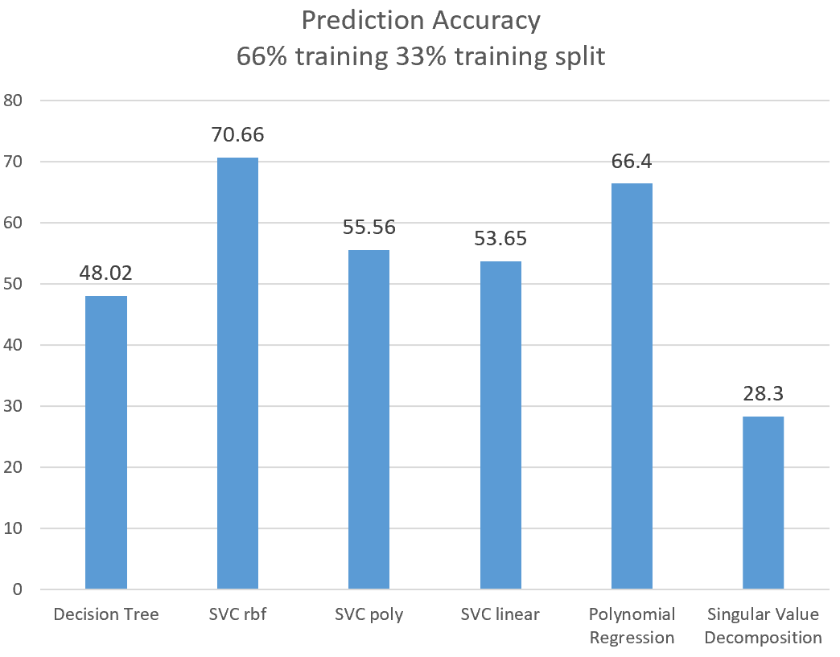
Real-Time Machine Learning-Based Gesture Recognition on mmWave Radar J. Smith, S. Thiagarajan, R. Willis, G. Balagopal, M. Torlak, Y. Makris The University of Texas at Dallas
OBJECTIVE:
Develop machine learning-based models for recognizing hand gestures from frequency response information of mmWave radar.
Setting up a MATLAB-based real-time platform for gesture recognition.
APPROACH:
Leveraging TI mmWave radar for collecting the frequency response of six unique gestures (2000 frequency response data captures each)
Down-converting and sampling the radar information for discretizing the gesture data.
Employing digital signal processing techniques to filter out relevant gesture information before classification.
Implementing data enhancement techniques for data reduction and enhancement. (ex. Principal Component Analysis, Singular Value Decomposition)
Building various machine learning models including support vector machines (SVM), decision trees, and polynomial regression on the collected data for modeling the data correlation.
Creating a MATLAB-based platform for real-time gesture recognition using the pre-trained machine learning model.
Radar Spectrum
RESULTS:
Successfully constructed MATLAB-based platform using the machine learning model to recognize gestures in real-time.
Highlights the potential of using machine learning with radar imaging in recognizing various gestures and/or objects.

